Slide 1
Concept Learning
Dr.Srinivas Battula
Associate Professor
School of CSE
VIT-AP University
References:
1. Tom M. Mitchell, Machine Learning , Chapter 2

Slide 2
Introduction
Much of learning involves acquiring general concepts from specific training examples
People, for example, continually learn general concepts or categories such as "bird," "car," "situations in which I should study more in order to pass the exam," etc.
Each such concept can be viewed as describing some subset of objects or events defined over a larger set (e.g., the subset of animals that constitute birds)

Slide 3








What is a Concept ?
Concept of
Dogs
Concept of
Cats
Concept of
Horses
Concept of
Birds
Concept of
Fishes
A concept describes a subset of objects or events defined over a larger set

Slide 4
Concept Learning
learning based on symbolic representations
Acquire/Infer the definition of a general concept or category given a (labeled) sample of positive and negative training examples of the category
Each concept can be thought of as a Boolean-valued (true/false or yes/no) function defined over larger set(e.g., a function defined over all animals, whose value is true for birds and false for other animals)
    Approximate a Boolean-valued function from examples
  Concept learning can be formulated as a problem of searching through a predefined space of potential hypotheses for the hypothesis that best fits the training examples
  Take advantage of a naturally occurring structure over the hypothesis space
    General-to-specific ordering of hypotheses
G
S

Slide 5
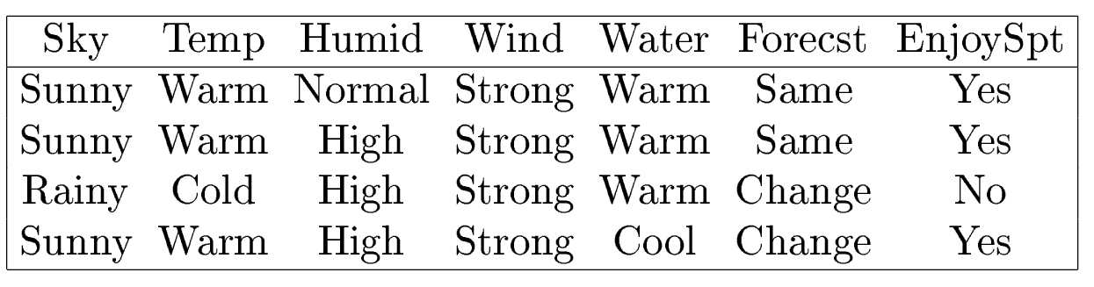
Training Examples for EnjoySport
Concept to be learned
  “Days on which Aldo enjoys his favorite water sport”
Days (examples/instances) are represented by a set of attributes
What is the general concept ?
  The task is to learn to predict the value of EnjoySport for an arbitrary day based on the values of other attributes
  Learn a (a set of) hypothesis representation(s) for the concept
Attributes
Days
Concept to be
learned
Notes:
The hypothesis representation consists of a conjunction of constraints on the instance attributes

Slide 6
Representing Hypotheses
Many possible representations for hypotheses h
Here h is conjunction of constraints on attributes
Each constraint can be
  For example a specific value (e.g., “Water=Warm” )
  Don’t care – any value is acceptible for this case(e.g., “Water=?” )
  No value acceptable (e.g., “Water=Ø ”)
  Sky AirTemp Humid Wind Water Forecast
  < Sunny ? ? Strong ? Same >
  Most general hypothesis
  Most specific hypothesis
A hypothesis is
a vector of constraints
  < ? ? ? ? ? ? >
All are positive
examples
All are negative
examples
  < Ø Ø Ø Ø Ø Ø >

Slide 7
Definition of Concept Learning Task
Given
  Instances X: possible days, each described by six attributes
  Sky, AirTemp, Humidity, Wind, Water, Forecast
  Target concept/function c : EnjoySport X → {0, 1}
  Hypotheses H : Conjunctions of Literals. E.g.,
  Training examples D : Positive and negative examples
  (members/nonmembers) of the target function (concept)
Determine
  A hypothesis h in H (an approximate target function) such that
  h(x)=c(x) for all x in D
  (Sunny, Cloudy, Rainy)
  (Warm, Cold)
  (Normal, High)
  (Strong, Week)
  (Warm, Cool)
  (Same, Change)
“No” “Yes”
  <?,Cold, High, ?, ?, ? >
  <x₁,c(x₁)>, <x₂,c(x₂)>,…., <x_{m},c(x_{m})>
target concept value

Slide 8
The Inductive Learning Hypothesis
Any hypothesis found to approximate the target function well over a sufficiently large set of training examples
will also approximate the target function well over other unobserved examples
  Assumption of Inductive Learning
    The best hypothesis regarding the unseen instances is the hypothesis that best fits the observed training data

Slide 9
Viewing Learning As a Search Problem
Concept learning can be viewed as the task of searching through a large space of hypotheses
Instance space X
Sky (Sunny/Cloudy/Rainy)
AirTemp (Warm/Cold)
Humidity (Normal/High)
Wind (Strong/Weak)
Water (Warm/Cool)
Forecast (Same/Change)
=> 3*2*2*2*2*2=96 instances
Hypothesis space H
5*4*4*4*4*4=5120 syntactically
distinct hypotheses
1+4*3*3*3*3*3=973 semantically
distinct hypotheses
Ø
Each hypothesis is represented as
a conjunction of constraints
  E.g.,
  < Ø Warm Normal Strong Cool Same >
  < Sunny Ø Normal Strong Cool Change>
Notes:
The representation of hypotheses defines the hypothesis space
Syntactically distinct hypotheses - Each Hypothesis is unique because of the rules of operation.
In the example, we have the following attributes (Sky, AirTemp, Humidity, Wind, Water, Forecast) for describing the target function. The following number of valid values for each of the attributes, respectively (3,2,2,2,2,2).
If we simply multiply them all, we get 96 distinct instances which are all distinct complete instances since they make use of all attributes.
If we go by the hypothesis design choice that each attribute can have one of the following types of values:
?(we consider any value of the attribute) or
a single value specified or
a 0(we do not consider the attribute at all)
Then we get the following valid values for each of the attribute (5,4,4,4,4,4). That is, we add two more possible values to the attribute "? and 0".
Combinations of this would result in 5120 distinct combinations. We get 5120 different hypotheses by applying the rule for each attribute and hence the name syntactically distinct hypothesis.
Semantically distinct hypotheses - Each Hypothesis is unique because of the logic applied to form the hypotheses.
Here, hypotheses that use all of the attributes to describe the Target function as Positive members (complete set) and those hypotheses that omit either one or multiple attributes as Negative members (empty set).
Then we have 972(4.3.3.3.3.3) distinct positive instances and 4148(5120-972) distinct negative instances.
Since the motive of the concept learner is to learn when Aldo gets to Enjoy his favourite water sport, we consider all hypotheses where he does not get to enjoy the water sport as one set of empty instance.
Hence, logically we have 972 distinct positive instances and One negative instance and therefore, a total of 973(1+(4.3.3.3.3.3)) semantically distinct hypotheses.

Slide 10
Viewing Learning As a Search Problem
Study of learning algorithms that examine different strategies for searching the hypothesis space, e.g.,
  Find-S Algorithm
  List-Then-Eliminate Algorithm
  Candidate Elimination Algorithm
How to exploit the naturally occurring structure in the hypothesis space ?
  Relations among hypotheses , e.g.,
    General-to-Specific-Ordering

Slide 11
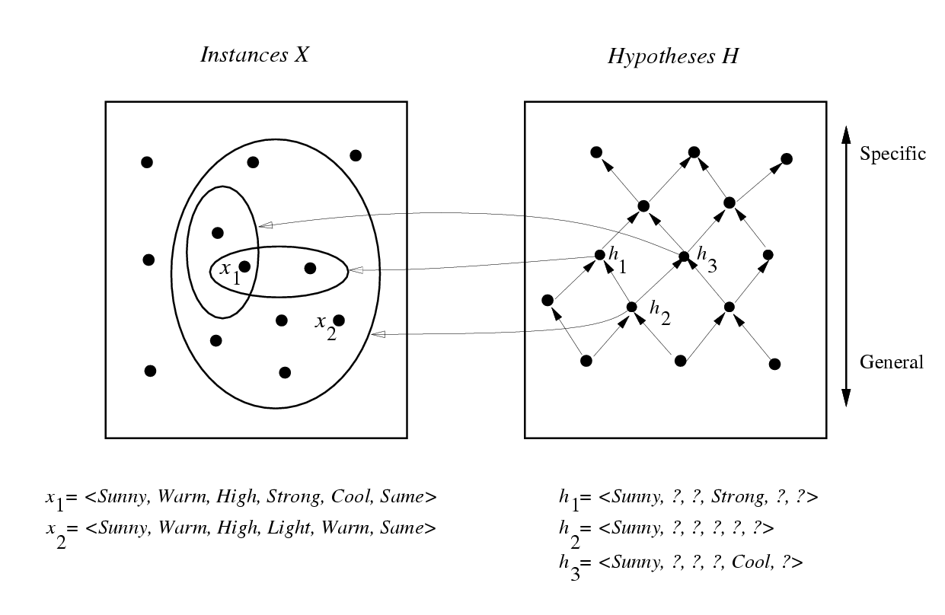
General-to-Specific-Ordering of Hypothesis
Many concept learning algorithms organize the search through the hypothesis space by taking advantage of a naturally occurring structure over it
  “general-to-specific ordering”
    h₂ is more general than h₁
      h₂ imposes fewer constraints on instances
      h₂ classify more positive instances than h₁ does
  A useful structure over the hypothesis space
Suppose that h₁ and h₂ classify
positive examples

Slide 12
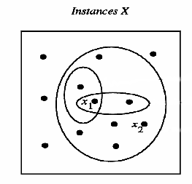

More-General-Than Partial Ordering
Definition
  Let h_{j} and h_{k} be Boolean-valued functions defined over X.
  Then h_{j} is more general than h_{k} (h_{j} >_{g} h_{k}) if and only if
We also can define the more-specific-than ordering
x satisfies h_{k}

Slide 13


General-to-Specific Ordering of Hypotheses
An illustrative example
Suppose instances are classified positive by h₁, h₂ , h₃
  h₂ (imposing fewer constraints) are more general than h₁ and h₃
  h₁ h₃
partial order relation
- antisymmetric, transitive
Notes:
Concept learning algorithms can take advantage of such partial order to efficiently organize the search for hypotheses that fit the training data
Relation R on set A is symmetric if (b, a)∈R and (a,b)∈R. Relation R on a set A is asymmetric if(a,b)∈R but (b,a)∉ R. Relation R of a set A is antisymmetric if (a,b) ∈ R and (b,a) ∈ R, then a=b. “Is equal to” is a symmetric relation, such as 3 = 2+1 and 1+2=3.

Slide 14

Find-S Algorithm
Find a maximally specific hypothesis by using the
more-general-than partial ordering to organize the search for a hypothesis consistent with the observed training examples
Initialize h to the most specific hypothesis in H
For each positive training instance x
  For each attribute constraint a_{i} in h
    If the constraint a_{i} in h is satisfied by x
    Then do nothing
    Else replace a_{i} in h by the next more general constraint that is satisfied by x
Output hypothesis h

Slide 15
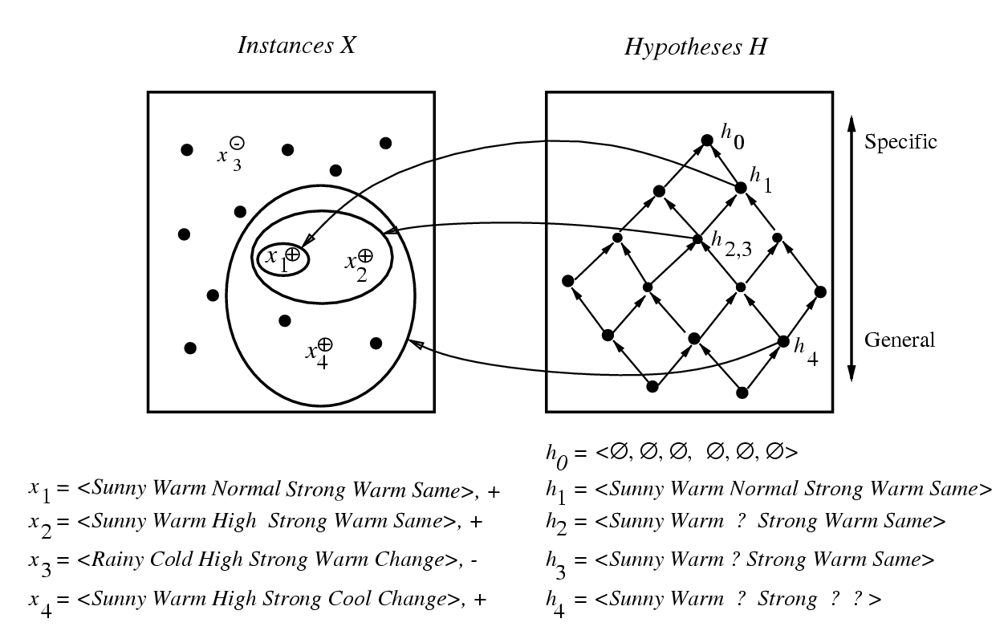
Find-S Algorithm
Hypothesis Space Search by Find-S
  Substitute a “?” in place of any attribute value in h that is not satisfied by the new example
no change!
Notes:
Find-S ignores all negative examples

Slide 16
Find-S Algorithm
Why F-S never check a negative example ?
  The hypothesis h found by it is the most specific one in H
  Assume the target concept c is also in H which will cover both the training and unseen positive examples
    c is more general than h
  Because the target concept will not cover the negative examples, thus neither will the hypothesis h
  can be represented as
  a conjunction of attributes

Slide 17
Complaints about Find-S
Can not tell whether it has learned concept
(Output only one. Many other consistent hypotheses may exist!)
Picks a maximally specific h (why?)
(Find a most specific hypothesis consistent with the training data)
Can not tell when training data inconsistent
  What if there are noises or errors contained in training examples
Depending on H, there might be several !
Notes:
find a most specific hypothesis consistent with the training data
=> If the correct target concept contained in H

Slide 18
Consistence of Hypotheses
A hypothesis h is consistent with a set of training examples D of target concept c if and only if
h(x)=c(x) for each training example <x, c(x)> in D
But satisfaction has another meaning
  An example x is said to satisfy a hypothesis h when h(x)=1, regardless of whether x is positive or negative example of the target concept

Slide 19

Version Space
Mitchell 1977
The version space VS_{H,D} with respect to hypothesis space H and training examples D is the subset of hypotheses from H consistent with all training
examples in D
  A subspace of hypotheses
  Contain all plausible versions of the target concepts

Slide 20
List-Then-Eliminate Algorithm
VersionSpace ← a list containing all hypotheses in H
For each training example, <x, c(x)>
  remove from VersionSpace any hypothesis h for which
  h(x)≠c(x)
  i.e., eliminate hypotheses inconsistent with any training examples
  The VersionSpace shrinks as more examples are observed
Output the list of hypotheses in VersionSpace

Slide 21
Drawbacks of List-Then-Eliminate
The algorithm requires exhaustively enumerating all hypotheses in H
  An unrealistic approach ! (full search)
If insufficient (training) data is available, the algorithm will output a huge set of hypotheses consistent with the observed data

Slide 22
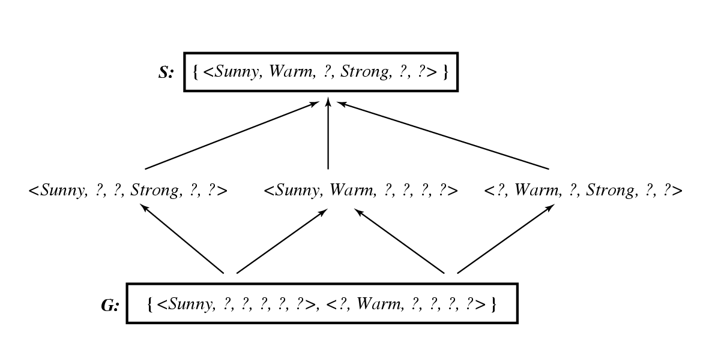
Example Version Space
Employ a much more compact representation of the version space in terms of its most general and least general (most specific) members
Specific
Also found by F-S
General
Arrows mean more-general-than relations

Slide 23
Representing Version Space
The General boundary G, of version space
VS_{H,D} is the set of its maximally general members
The Specific boundary S, of version space
VS_{H,D} is the set of its maximally specific members
Every member of the version space lies between
these boundaries
  Version Space Representation Theorem

Slide 24


Candidate Elimination Algorithm
Mitchell 1979
G ← maximally general hypotheses in H
S ← maximally specific hypotheses in H
Should be specialized
Should be generalized

Slide 25
Candidate Elimination Algorithm
For each training example d, do
  If d is a positive example
    Remove from G any hypothesis inconsistent with d
    For each hypothesis s in S that is not consistent with d
      Remove s from S
      Add to S all minimal generalizations h of s such that
        h is consistent with d, and
        some member of G is more general than h
      Remove from S any hypothesis that is more general than another hypothesis in S
      (i.e., partial-ordering relations exist)
positive training examples force the S boundary become increasing general

Slide 26
Candidate Elimination Algorithm
  If d is a negative example
    Remove from S any hypothesis inconsistent with d
    For each hypothesis g in G that is not consistent with d
      Remove g from G
      Add to G all minimal specializations h of g such that
        h is consistent with d, and
        some member of S is more specific than h
      Remove from G any hypothesis that is less general than another hypothesis in G
negative training examples force the G boundary become increasing specific

Slide 27
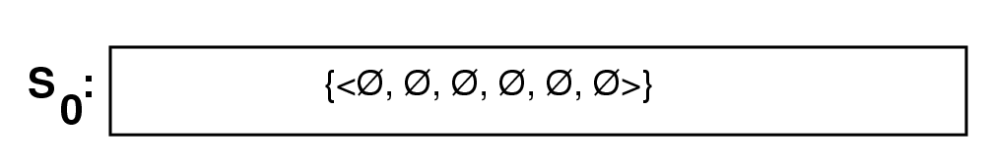
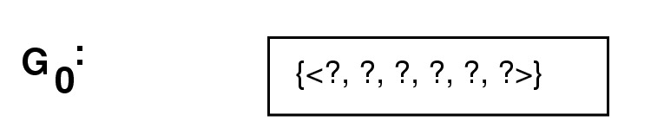
Example Trace

Slide 28
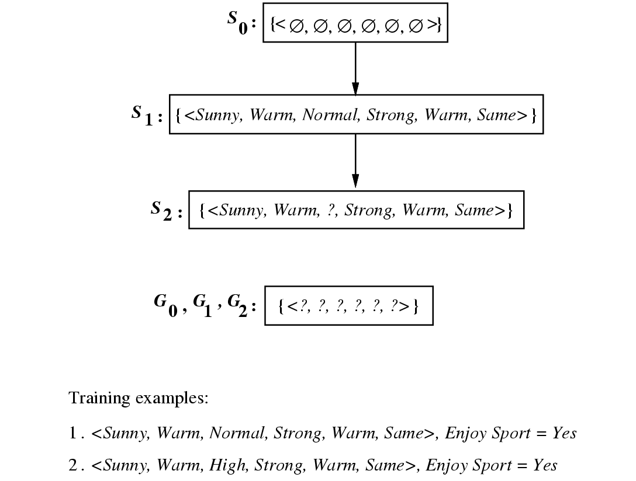
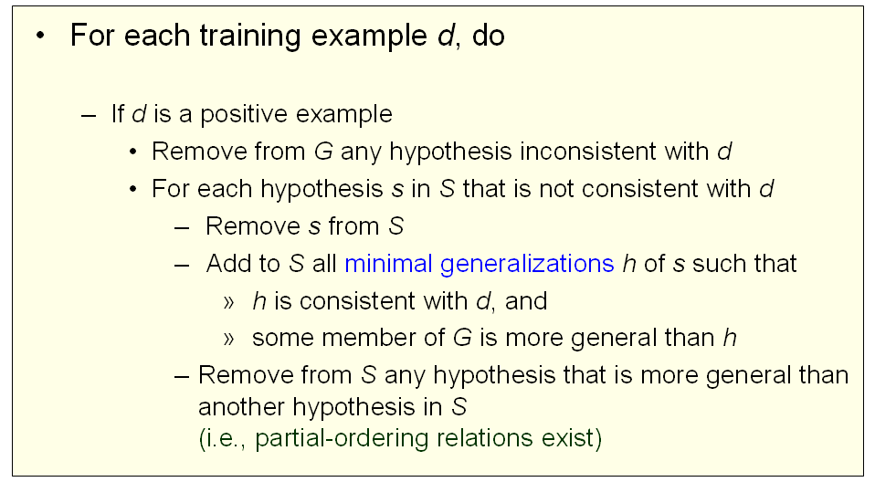
Example Trace

Slide 29
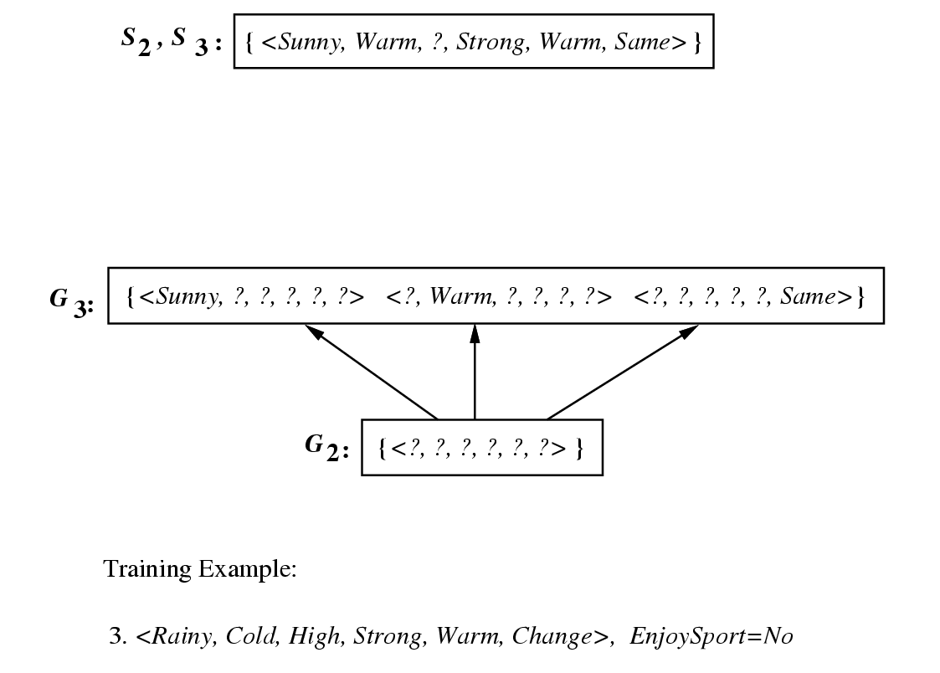
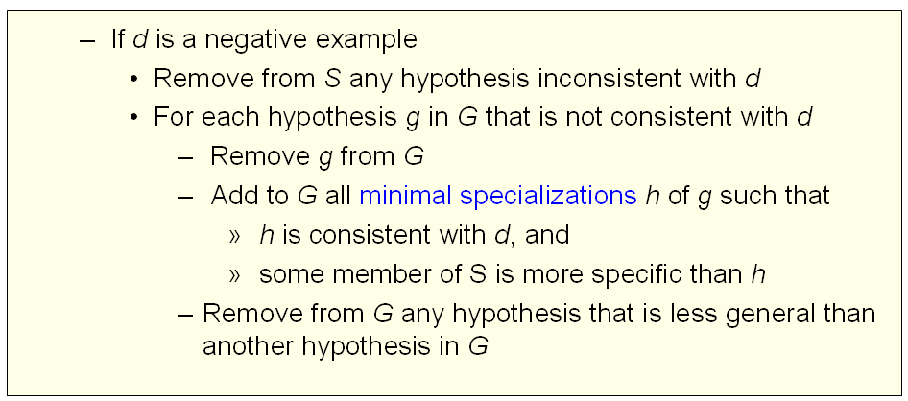
Example Trace
G₂ has six ways to be minimally specified
  Why <?,? ,Normal,?,?,? > etc. do not exist in G₃ ?
  < ? ? Normal ? ? ?>
?
Notes:
They are more specific than S₃

Slide 30
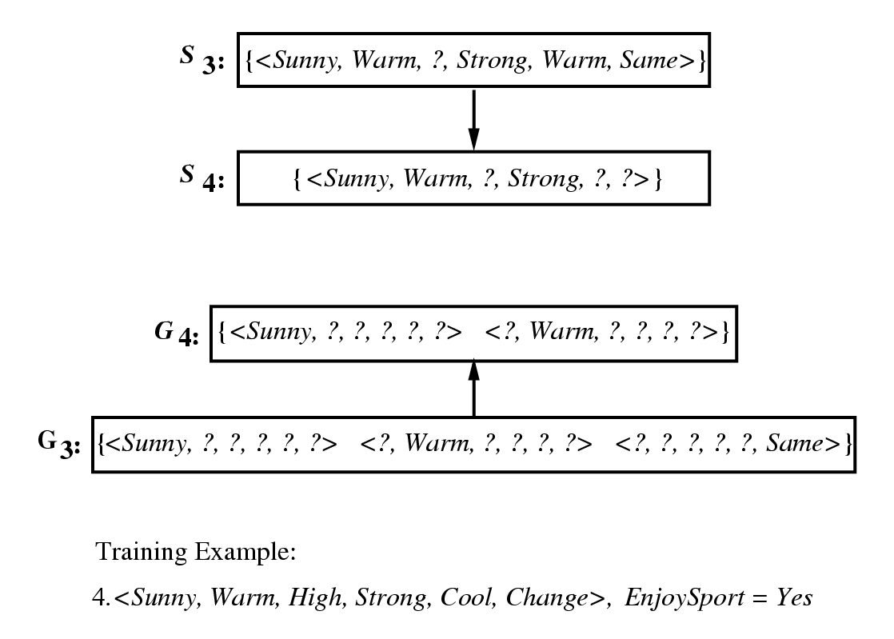
Example Trace
Notice that,
  S is a summary of the previously positive examples
  G is a summary of the previously negative examples

Slide 31
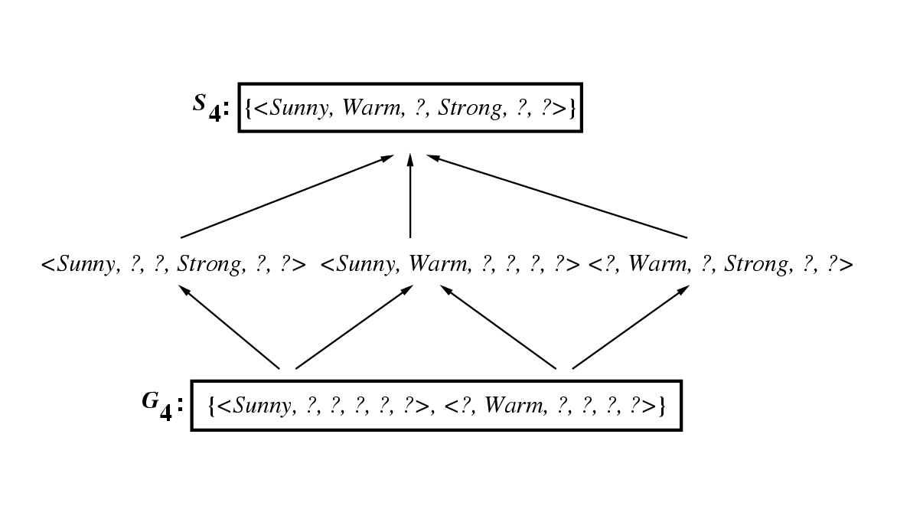
Example Trace
S and G boundaries move monotonically closer to each other, delimiting a smaller and smaller version space
Notes:
The learned VS is independent of the sequence in which the training samples are presented

Slide 32
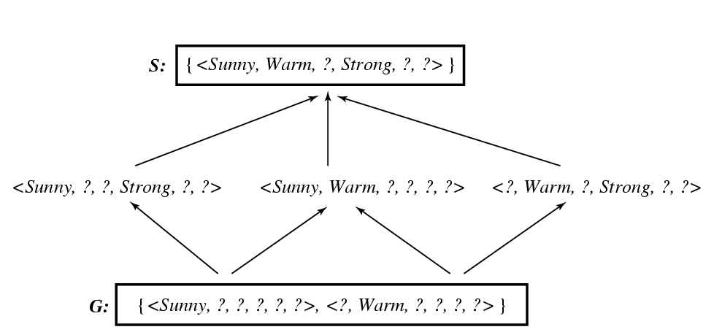
What Next Training Example
Learner can generate useful queries
  Discriminate among the alternatives competing hypotheses in the current version space
Specific
General
  If a positive hypothesis is posed:
  <Sunny, Warm, Normal, Light, Warm, Same >
  What if it is a negative one ?

Slide 33
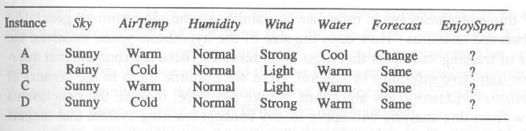
How Should These Be Classified ?
Yes ?
No ?
?
?
Notes:
A, B, C, D : positive, negative, half, 2/4

Slide 34
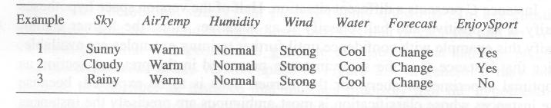
Biased Hypothesis Space
Biased hypothesis space
  Restrict the hypothesis space to include only conjunctions of attribute values
  I.e., bias the learner to consider only conjunctive ypothesis
Can’t represent disjunctive target concepts
“Sky=Sunny or Sky=Cloud ”
  After the first two examples learned:
  <?, Warm, Normal, Strong, Cool, Change>

Slide 35
Summary Points
Concept learning as search through H
General-to-specific ordering over H
Version space candidate elimination algorithm
  S and G boundaries characterize learners uncertainty
Learner can generate useful queries

